Slide 1
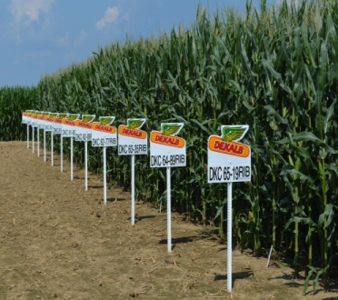
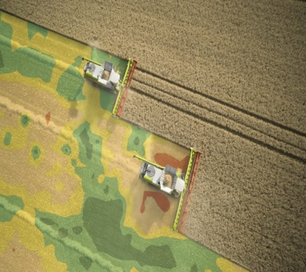
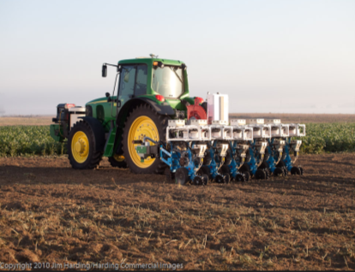
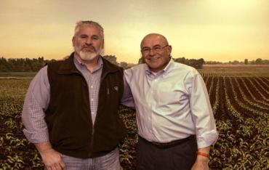
Global Breeding Analytics Team – Vision Our Mission: Harvesting Value Through Analytics
ENRICHED PIPELINE DECISIONS
OPTIMIZED
WORKFLOWS
CHARACTERIZED ENVIRONMENTS
PRECISE PRODUCT PLACEMENT
ENHANCED PRODUCT MANAGEMENT
PRESCRIBED PIPELINE
IMPROVED CUSTOMER EXPERIENCE
Notes:
Break this down how to achieve
Gaps
Top 3 I need to deliver

Slide 2
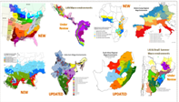
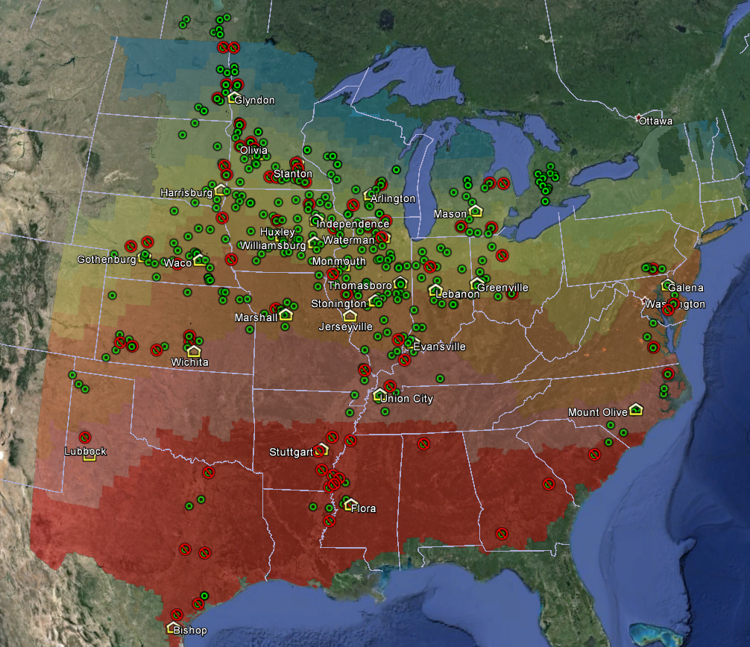
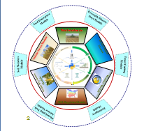
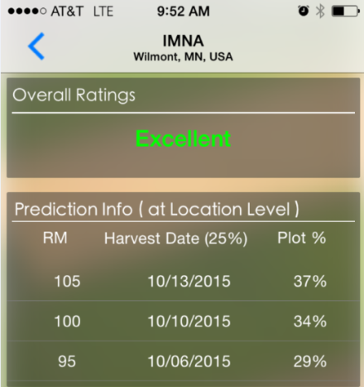
Environment & Spatial Analytics Strategy Aligned with GBA Vision
Environment Classification
Phenotyping Network Optimization
Analytics
EBLUPS
EGWS
OR
Prescriptive Pheno.
PPP
OPTIMIZED
WORKFLOWS
CHARACTERIZED ENVIRONMENTS
Site (Location) Characterization
PRESCRIBED PIPELINE
Environmental Predictions

Slide 3
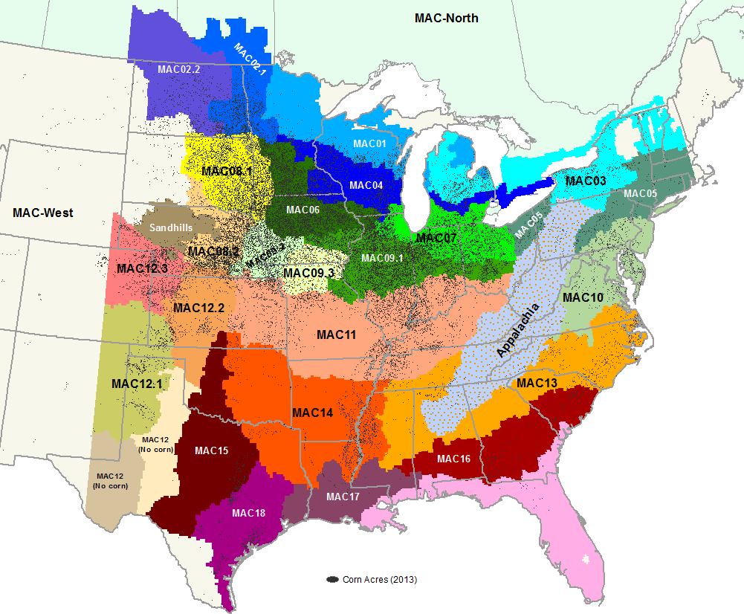
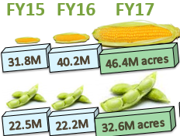
Environment & Spatial Analytics Team – Strategy
Environment Classification
Phenotyping Network Optimization
Site (Location) Characterization
Environmental Predictions
MACs
Weather Watch
Cross-region MACs
Disease MACs
Weather Regimes
Testing Footprint Opt.
Allocation
Prescriptive Phenotyping
Drought
Heat
Actual RM (GDU)
Soil
Management Practices
Weather Regimes
Disease pressure
Plot-level “E”
Drought stress
Heat stress
Growth Stage/drydown
Disease risk/pressure
Emergence risk

Slide 4
Vision: Premier Environmental & Spatial Analytics Data Science Team in Monsanto

Slide 5
Where do we influence?
Environmental & Spatial Analytics
Breeding
TD&A
Manufacturing (GSC)
TPD
Regulatory
API (Chemistry)
Biotech
Climate

Slide 6
Vision & Mission: Does this resonate with you?
Rewrite the Vision/Mission to reflect the new team?
Modeling
Learning
Something that matters
Need: systems/processes for streamlining repetitive work
Research, cutting-edge within Monsanto and outside
Discovery
Potential to work at range of scales – process modeling, stats, understanding drivers
What is the science?
Impacting experimental design, data collection
Unify within team
Communicate message across organization

Slide 7
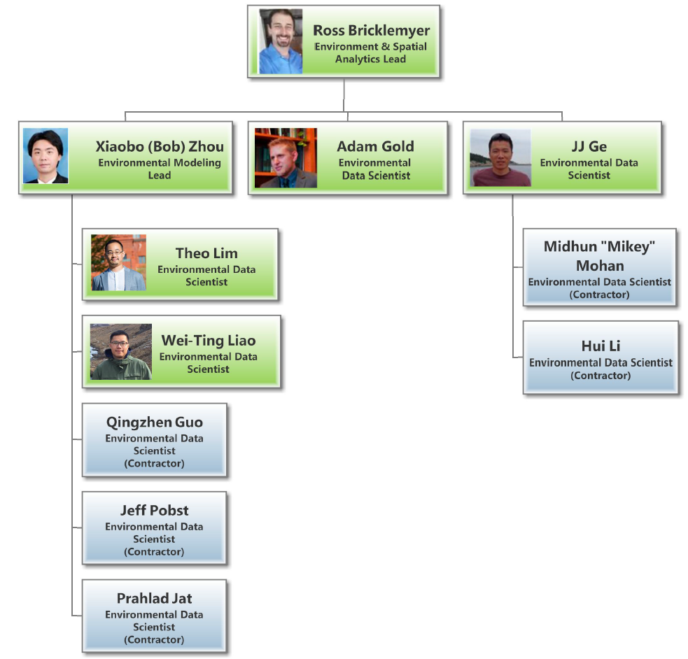
Environment & Spatial Analytics Team Our Mission: Best in-class product characterization, positioning and transfer globally.

Slide 8
Vision: Premier Environmental & Spatial Analytics Data Science Team in Monsanto
Our Mission: Best in-class product characterization, positioning and transfer, globally.
More focus on Environments, decisions,impact

Slide 9
Mission statements
Best in-class environmental characterization and prediction for advancing and positioning products globally. [Vision]
Develop and integrate high-quality, science-based, spatial-temporal environmental analyses and data products that support and drive decision-making in the breeding and product development pipelines. [Mission]
Enhancing breeding analytics through environmental (characterization, understanding) [vision]
Empowering Decision Making through Environmental Analytics [mission]
Harvesting more value through Environmental Analytics [mission]
Environmental Analytics, Breeding (3.0) and Beyond
A better world through Environmental Analytics

